Slide 1

Quality of Experience in Next-Generation Networks
Akademia Górniczo-Hutnicza im. Stanisława Staszica w Krakowie
AGH University of Krakow
February 6, 2025

Slide 2
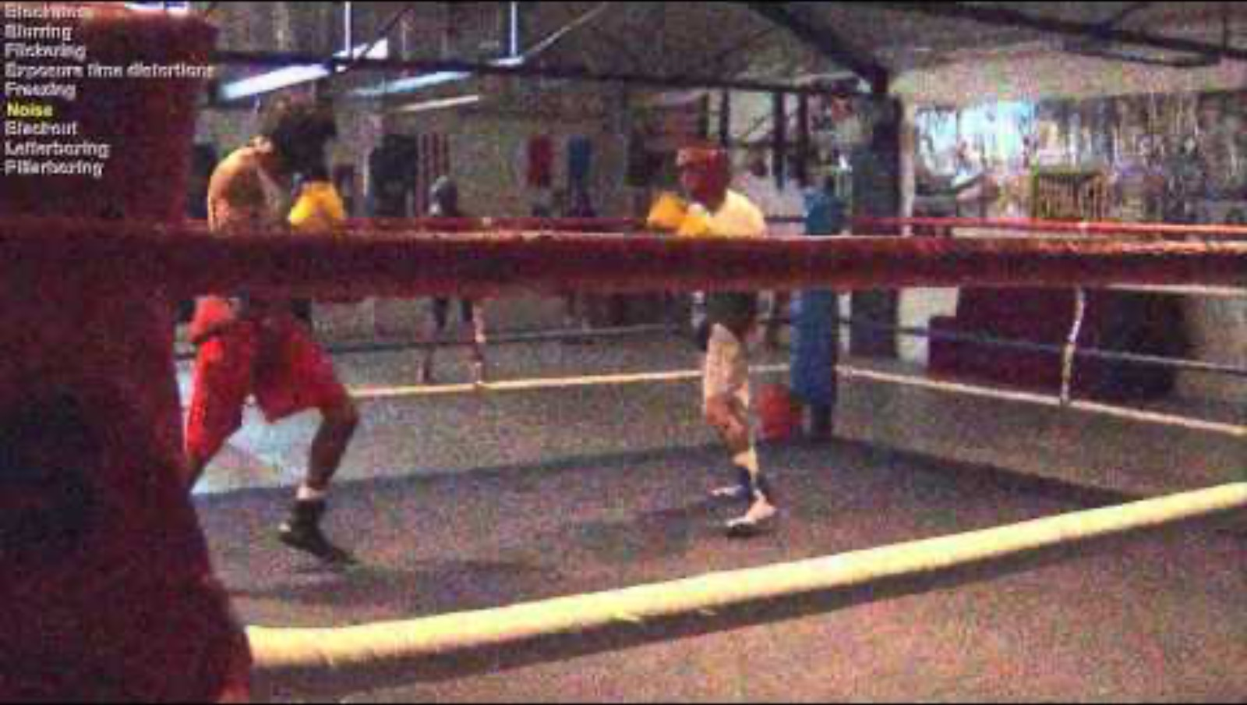
Project Overview
This project focuses on Quality of Experience (QoE) in next-generation networks. We integrate user-centric metrics with technical assessments to develop advanced models for optimizing multimedia services. Our innovations include real-time monitoring tools and predictive QoE models, ensuring superior user experiences in dynamic network environments.

Slide 3
From Quality of Service (QoS) to Quality of Experience (QoE)
QoS
Quality model
QoE
Pixels
Calibration
What we know
What we build
What we want

Slide 4

Key Innovations
Real-time quality monitoring tools
Predictive QoE models for adaptive streaming
Strategies for mitigating network disruptions
Global scalability of QoE optimization techniques

Slide 5

Applications
Our research impacts video streaming, online gaming, and telecommunication services. By enhancing QoE, we improve service delivery, user engagement, and network efficiency.

Slide 6

Technical Implementation
Our solution includes a Python package for video quality analysis, executable tools for multiple OS platforms, and BASH/BATCH scripts leveraging ffmpeg for bulk processing. Key indicators such as Blockiness, Blur, Contrast, and Noise are integrated for comprehensive assessment.

Slide 7
Indicators and Metrics
Commercial Black
Blockiness
Block Loss
Blur
Contrast
Exposure
Flickering
Freezing
Interlacing
Letter-boxing
Noise
Pillar-boxing
Slicing
Spatial Activity
Temporal Activity
Colourfulness
Blur Amount
User-Generated Content
Lip Sync (coming soon)

Slide 8
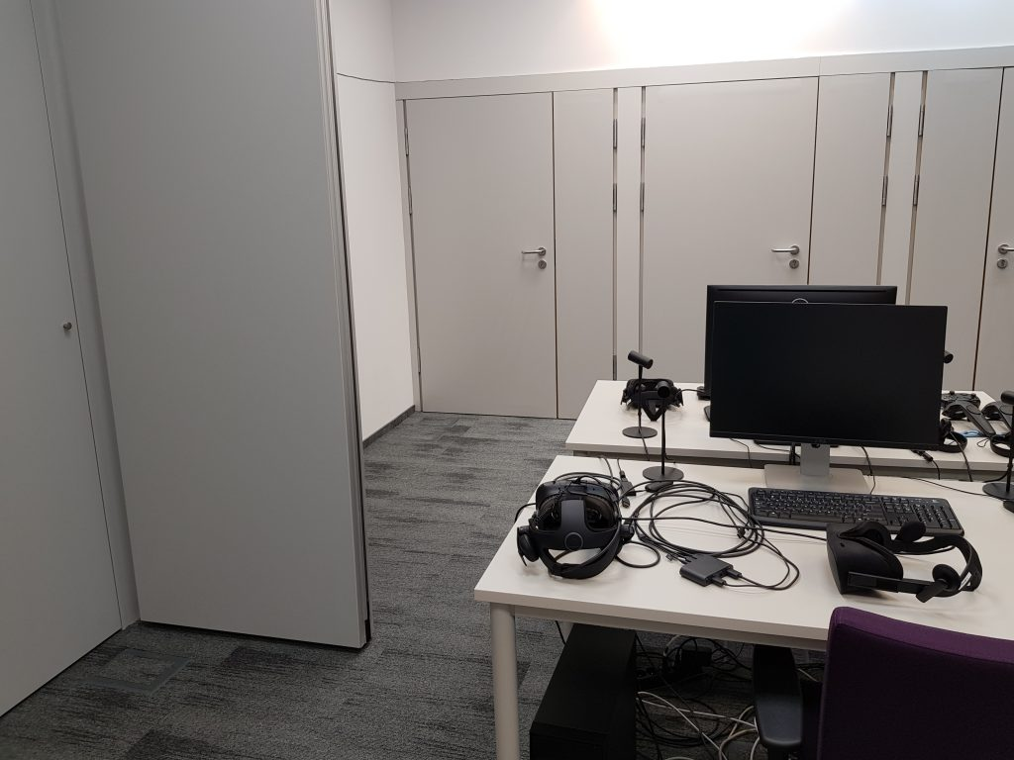
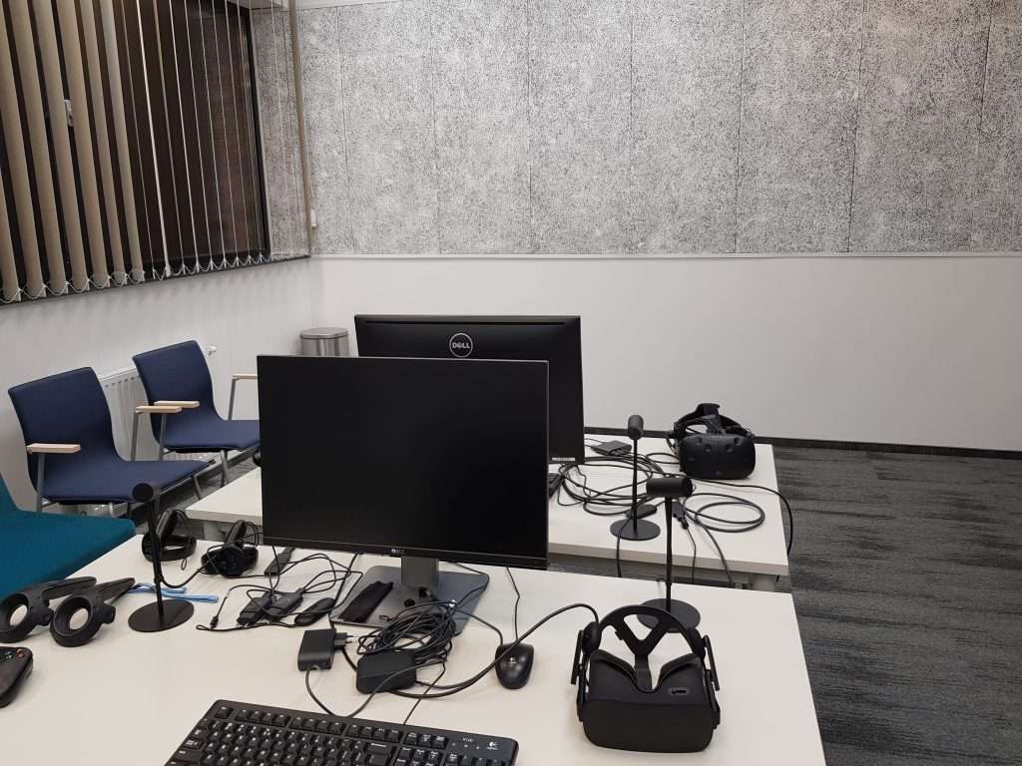
Laboratory Facilities
Dedicated QoE Lab with acoustic and light isolation for controlled testing environments
VR equipment including two Oculus Rift sets for immersive experience research

Slide 9
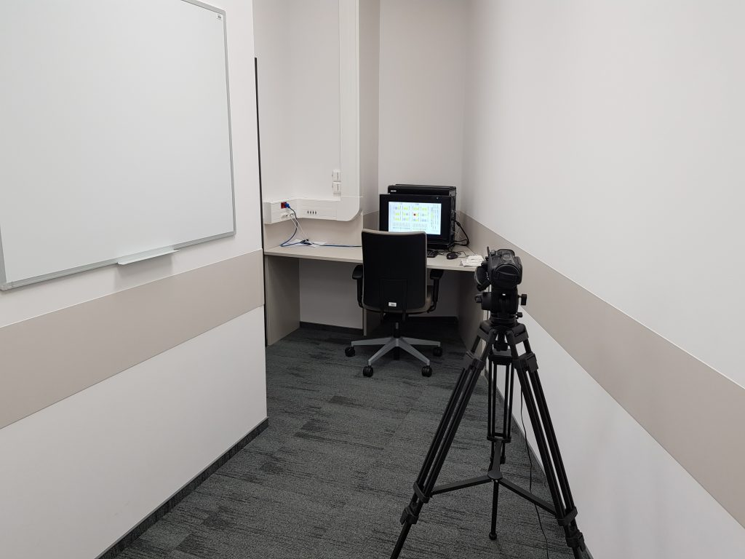
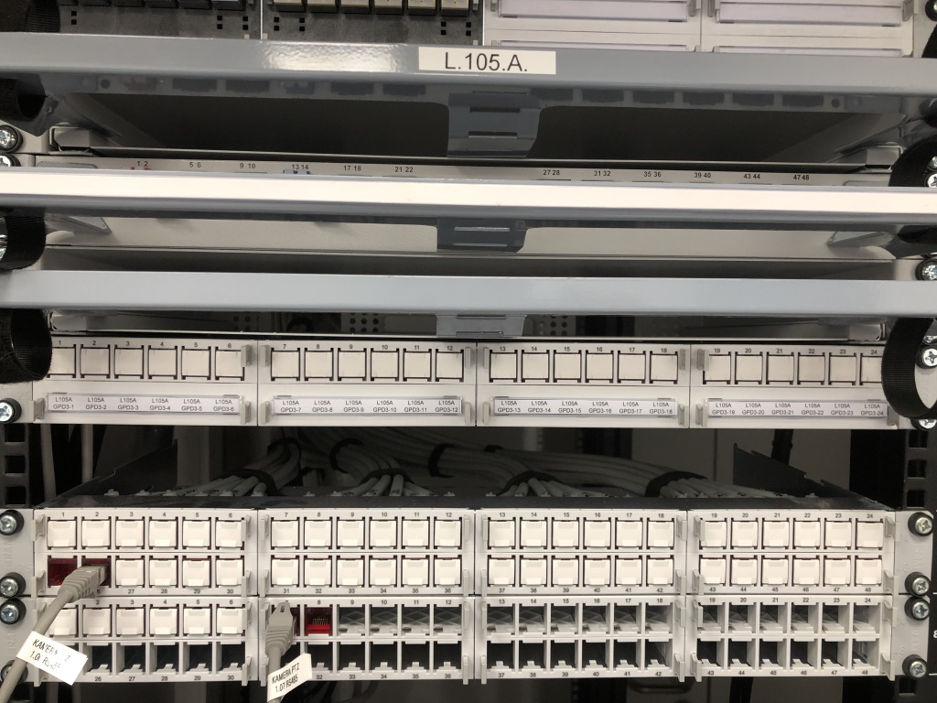
Advanced Testing Infrastructure
High-definition cameras for recording tester behavior with remote control capabilities
Modern networking infrastructure enabling the simulation of diverse network conditions

Slide 10

Future Developments
We are working on expanding our indicator set, integrating lip-sync analysis, and improving support for resolution changes. Further research includes AI-driven adaptive streaming techniques and user-generated content differentiation.

Slide 11
Team & Collaboration
Our interdisciplinary team at AGH University collaborates with international partners to address the multifaceted nature of QoE research, ensuring global relevance and impact.

Slide 12

Contact Us
AGH University of Krakow
Address: al. Mickiewicza 30, 30-059 Krakow, Poland
Email: qoe@agh.edu.pl
Website: https://qoe.agh.edu.pl

Slide 13
Thank You!

