Slide 1
A Novel Renewable Energy System for Residential Building Heating and Electricity Production
prof. dr hab. inż. Paweł Ocłoń

Slide 2

In the RESHeat project, the Cracow University of Technology is the project coordinator, while the partners are leading European research institutions, namely:
Sapienza University of Rome (Italy),
Brno University of Technology (Czech Republic),
as well as companies and firms in the SME sector, i.e.
OILON OY (Finland),
F.H.U. CZAMARA SC (Poland),
ELFRAN Franciszek Ścisłowicz (Poland).
Demonstration installations carried out in multi-family residential buildings owned by:
Municipal Buildings Management Board in Krakow,
ATER Provincia di Roma (Italy) – Building Management Board in Lazio region,
TOP CEZAR (Limanowa) - private company.
Funding and Acknowledgements
Project under the Horizon 2020 Financial Perspective, programme H2020-LC-SC3-2018-2019-2020: "Building a Low-Carbon, Climate Resilient Future: Secure, Clean and Efficient Energy".
The total funding is more than 2.4 mln EUR.

Slide 3
A. Development of a heating and hot water system to cover at least 70% of the annual energy demand for multi-family residential buildings from RES.
B. Demonstrate the actual performance (including economic performance) of the system and provide the end user with information on the overall performance of the system.
C. Demonstration of system scalability for different types of multi-family residential buildings.
Three demonstration plants are made, in Limanowa, Krakow and a suburb of Rome, for multi-family buildings with 9, 13 and 24 flats respectively. In addition, the system will be modified so that it also works efficiently for cooling, as tests in Italy will demonstrate.
D. Achieve TRL level of 8, system should be ready for commercialization
The main objective of the project is to prepare the RESHeat system for commercialization.
Project objectives
The main objective of the project is to prepare the RESHeat system for commercialization.
Keywords:
1) Renewable Energy,
2) Heating and Cooling
3) Seasonal Thermal Energy Storage
4) Energy Efficiency

Slide 4
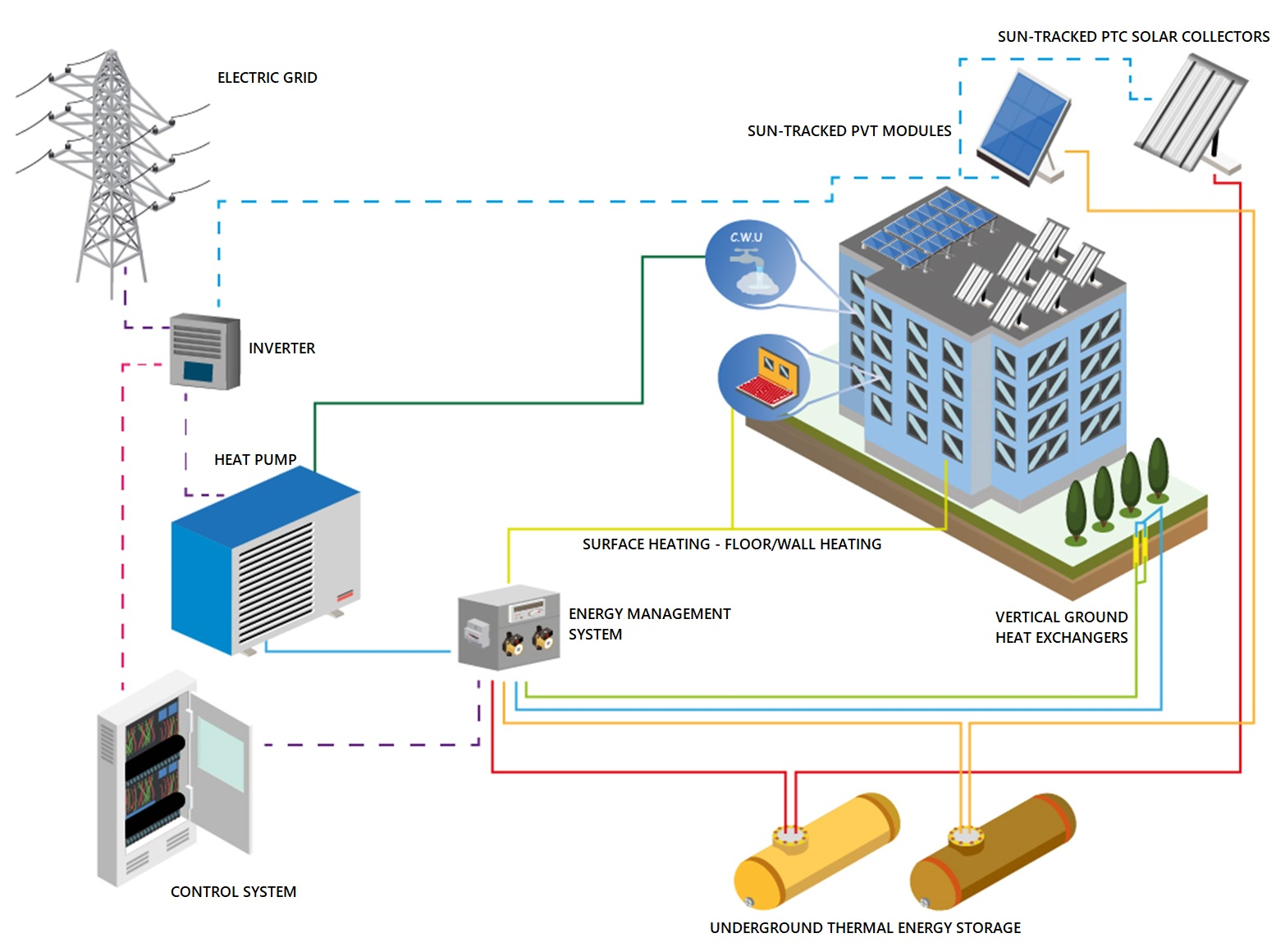
System concept
The idea behind the RESHeat project is to develop a zero-carbon and autonomous energy system based only on Renewable Energy Sources (RES).
RESHeat is an energy trigeneration system,thus uses RES to produce electricity, heat and cooling for residential (including passive), public and commercial buildings.

Slide 5
System concept
1) Using solar energy as a primary RES source:
  Electricity production from PV modules;
  Utilization of solar tracking systems;
  More efficient use of solar energy through the
  use of PV-T modules
2) Heating and cooling the building
using a heat pump;
3) Seasonal thermal energy storage in underground storage facilities;
4) Using waste heat from PV-T modules or solar thermal collectors
for ground regeneration
5) Maintaining the high COP of the heat pump
during the heating season.
The idea behind the RESHeat project is to develop a zero-carbon and autonomous energy system based only on Renewable Energy Sources (RES).

Slide 6













Project implementation
Design and development
System components
System integration
RESHeat system distribution
End Users

Slide 7
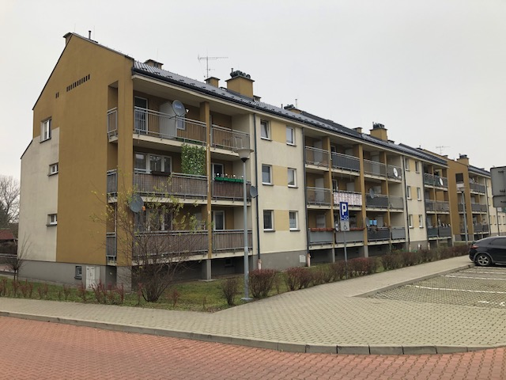
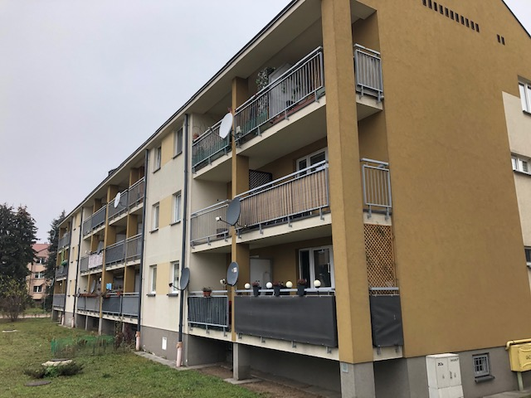
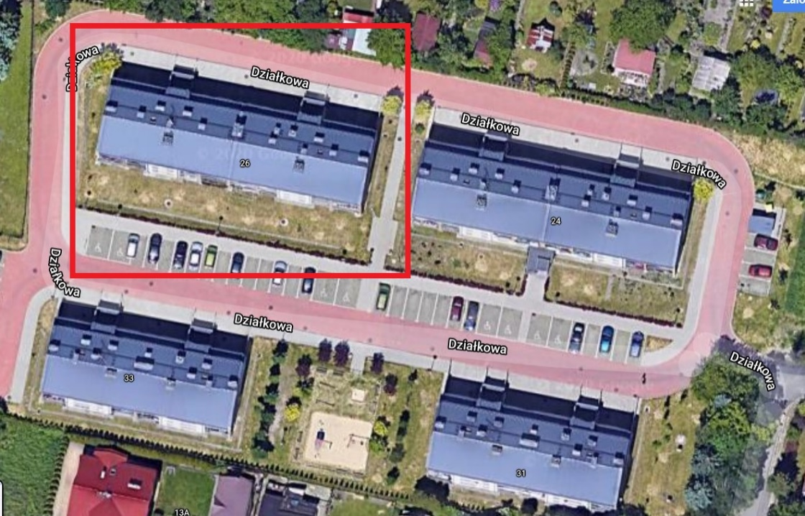
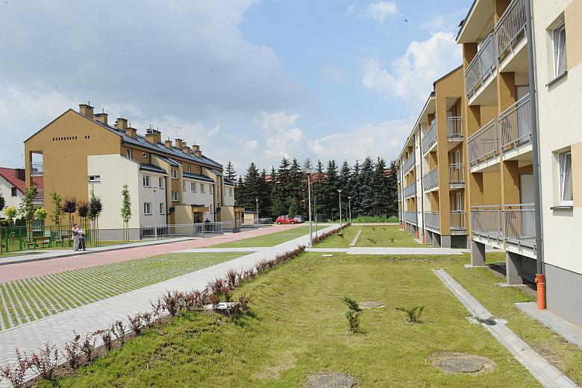

RESHeat demo in Krakow
Location: 26 Działkowa Street, Kraków
year of construction: 2013
number of flats: 24
heating: natural gas.
Next door an identical building.
During the project it is possible
to compare heating costs
for before/after retrofitting
Promo video→

Slide 8
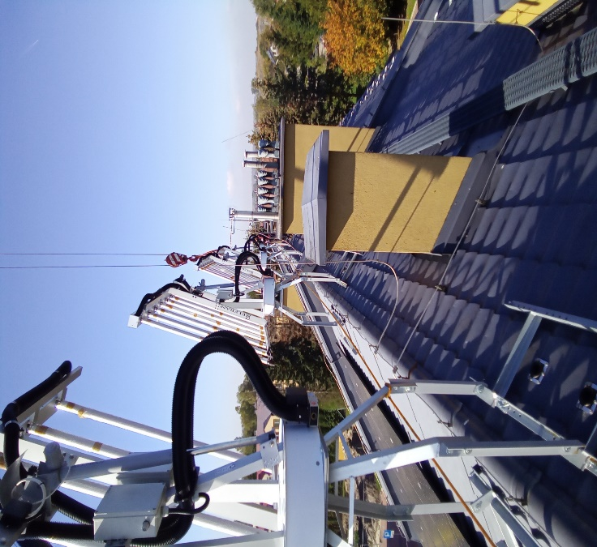
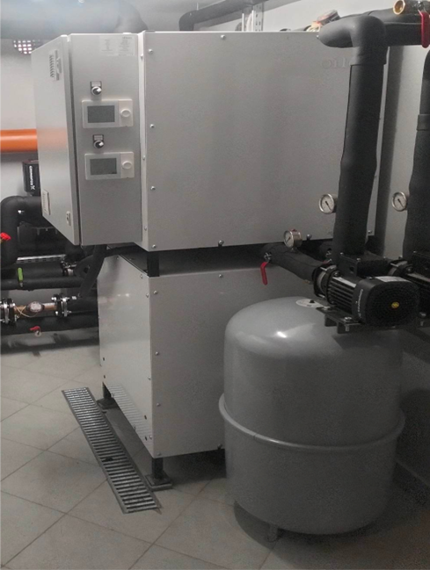
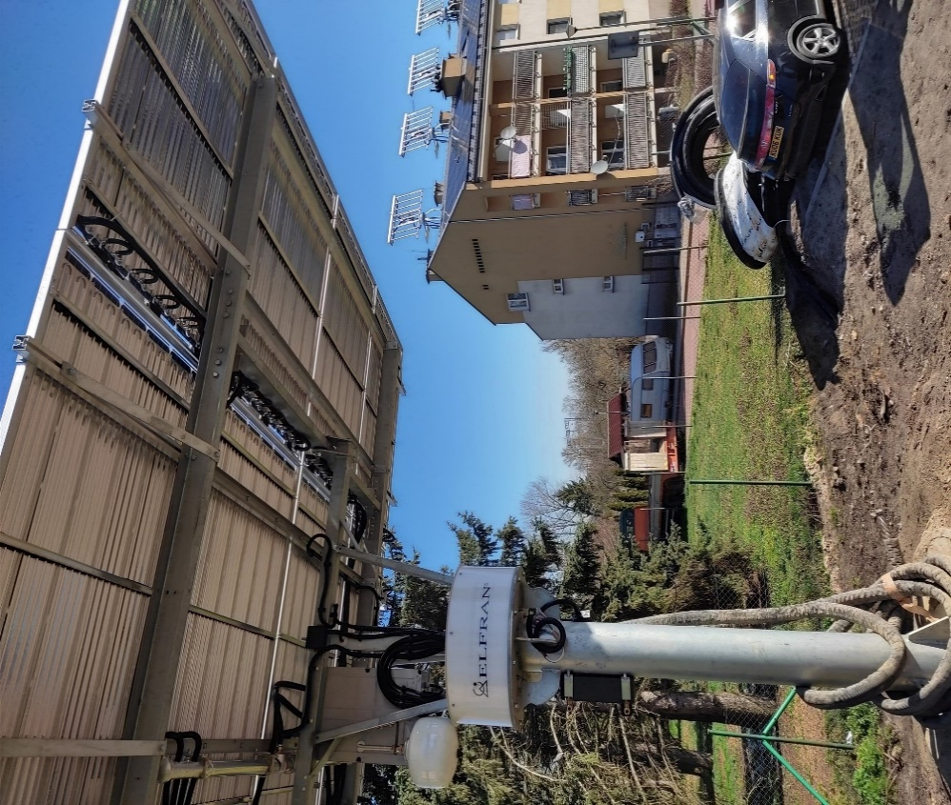
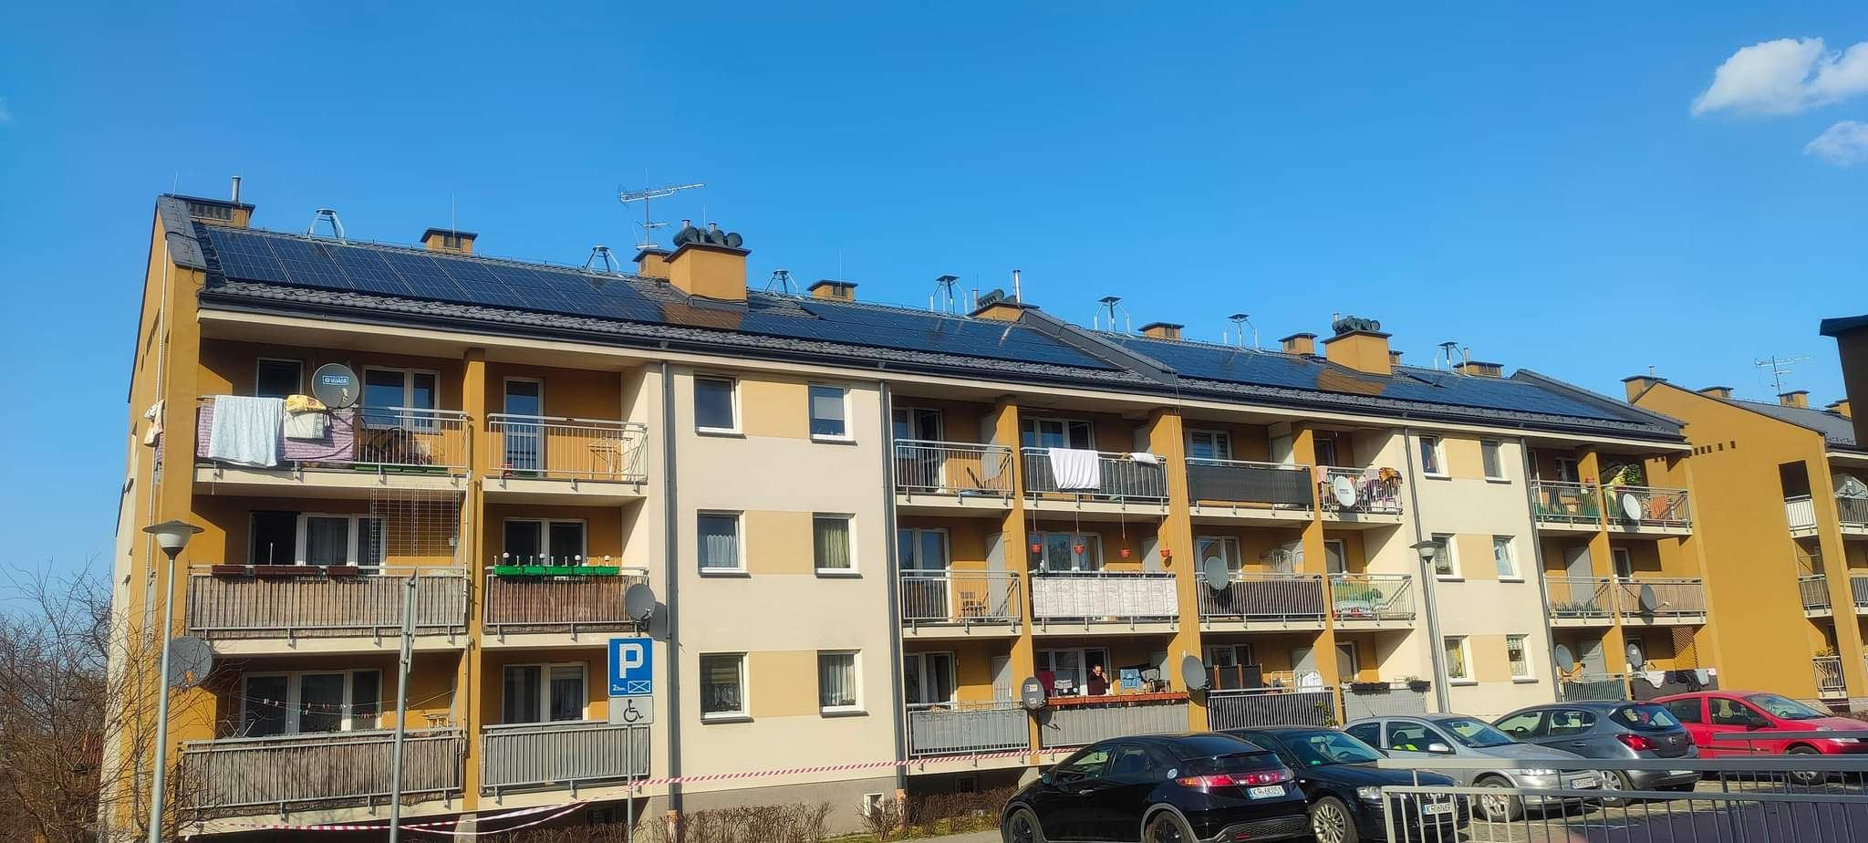
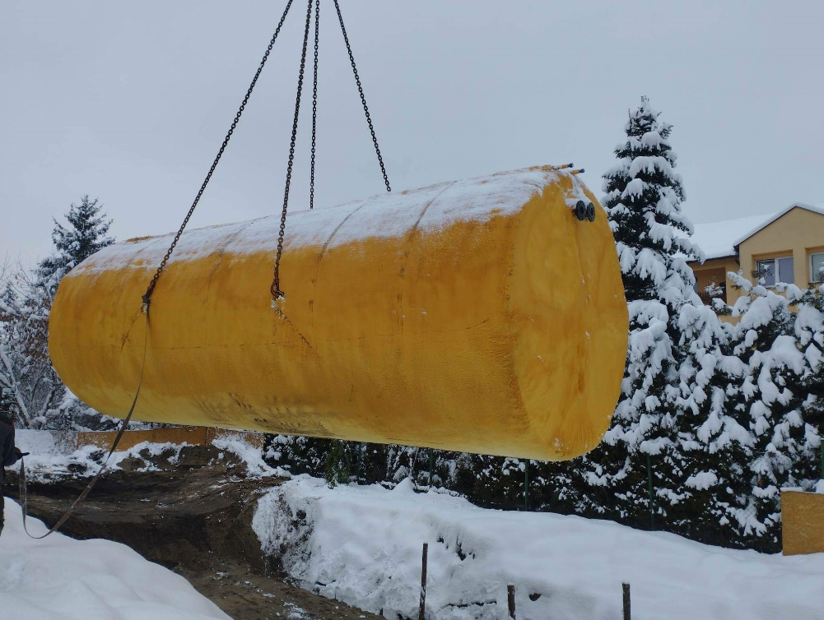
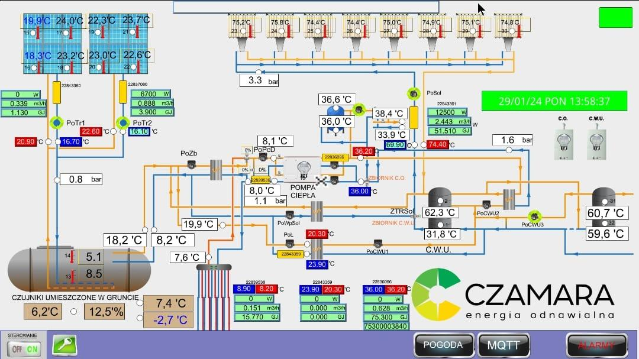
RESHeat demo in Krakow
Installation power:
Solar collectors on trackers: 30.4 kWt
PVT modules on trackers: 10.4 kWe, 5.6 kWt
Stationary PV panels: 30 kWe (68 pcs.)
Heat pump: 95 kW
Underground heat storage: 50m³
Sun-tracked solar collectors
OILON RE 76
Heat pump
Sun-tracked PV/T modules
PV pannels instalation
Underground heat storage tank
50 m³ volume
Control panel

Slide 9
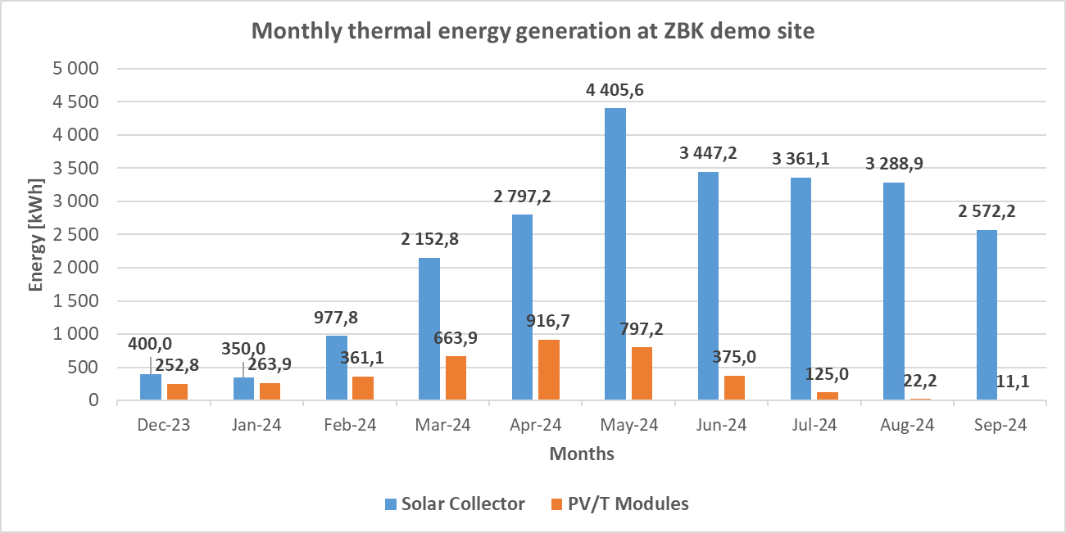
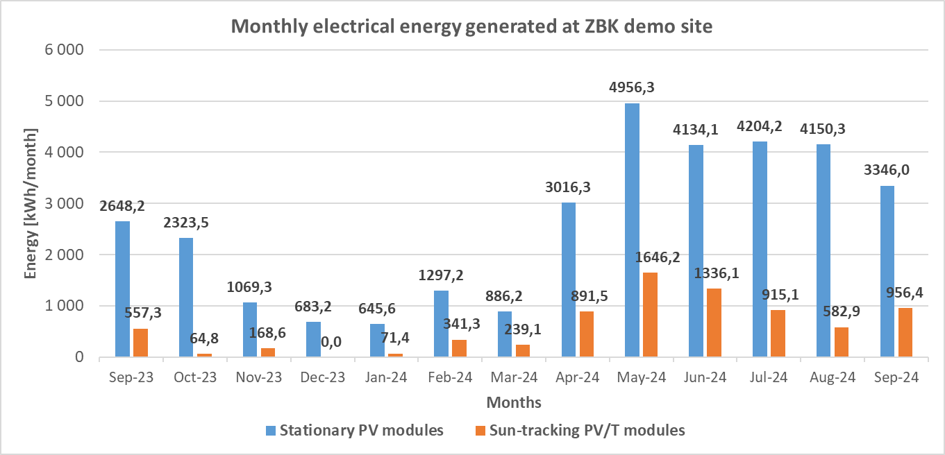
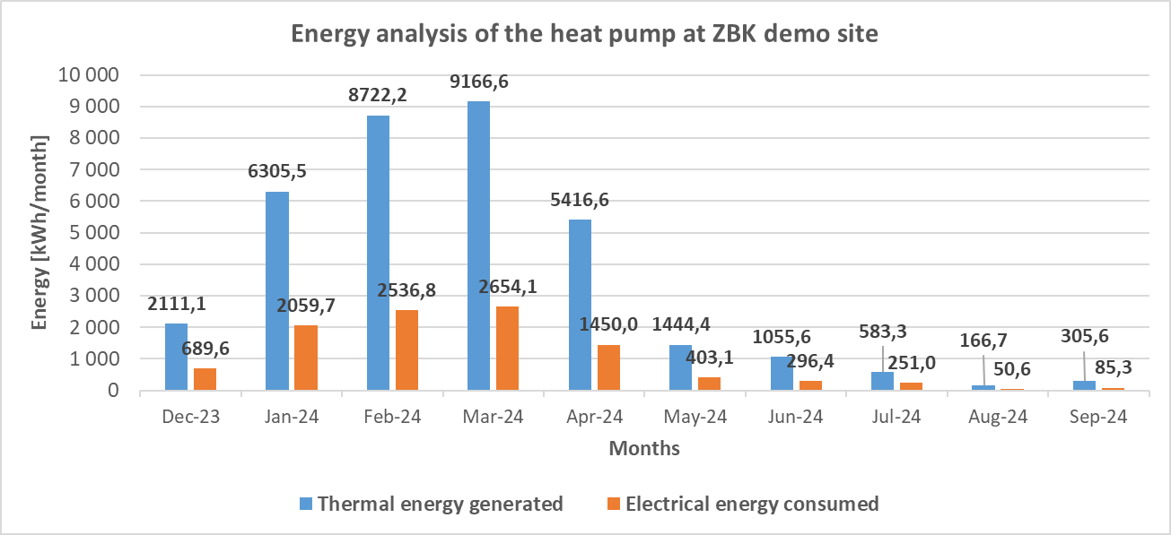
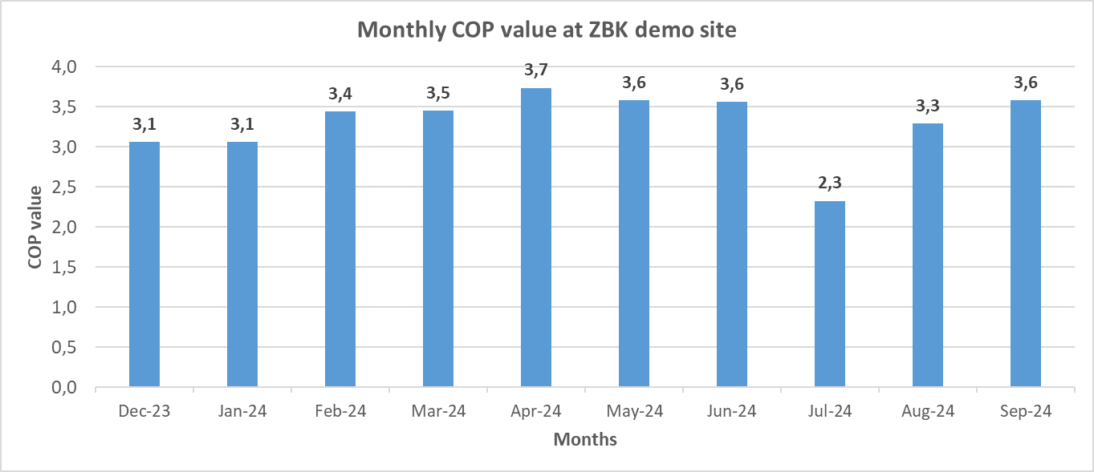
RESHeat - demo in Krakow

Slide 10
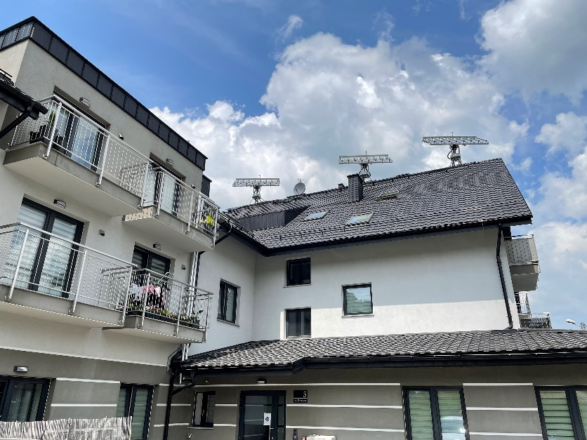
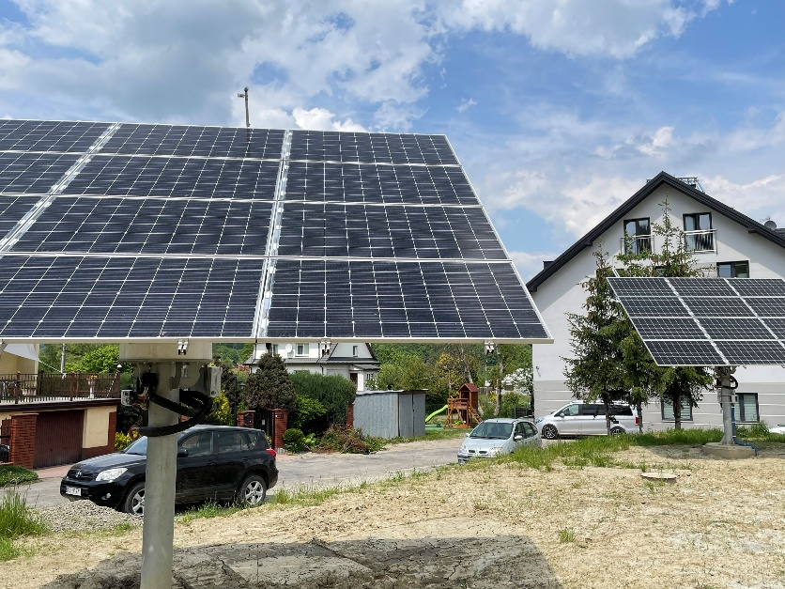
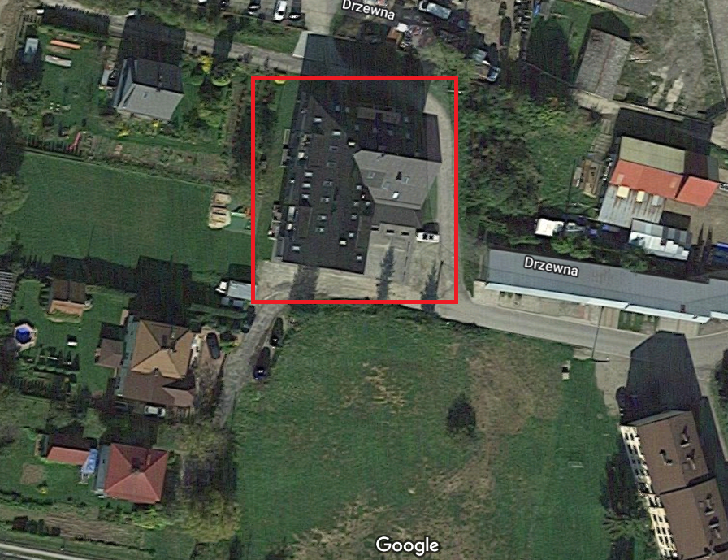
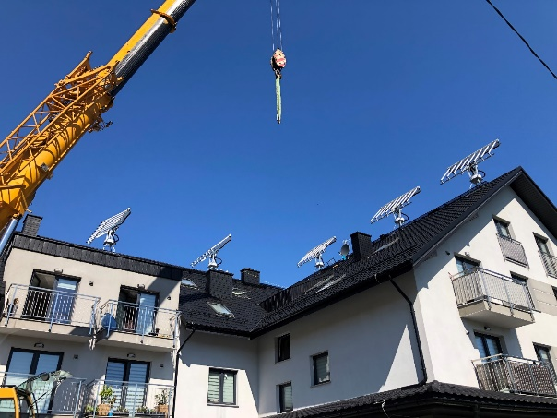
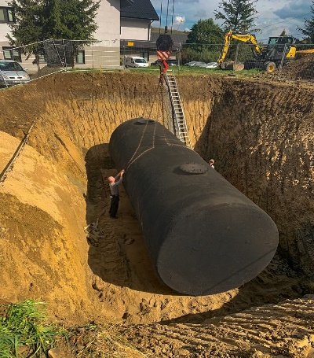
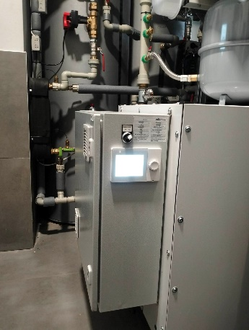
RESHeat - demo in Limanowa
Installation power:
Solar collectors on trackers: 19 kWt
PVT modules on trackers: 10.4 kWe, 5.6 kWt
Stationary PV panels: 19.4 kWe (44 units).
Heat pump: 42 kW
Underground heat storage: 50m³
Location: 5 Drzewna Street, Limanowa
year of construction: 2017
number of flats: 9 (ground floor only)
heating: natural gas.

Slide 11
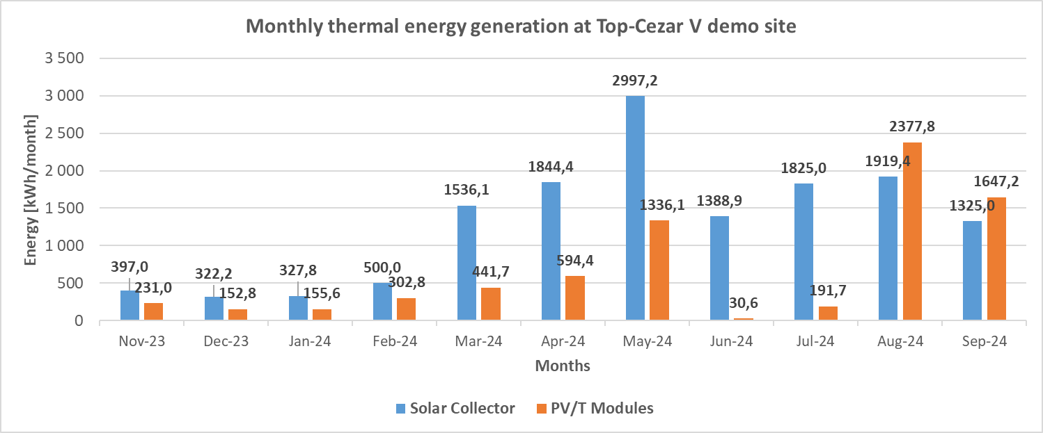
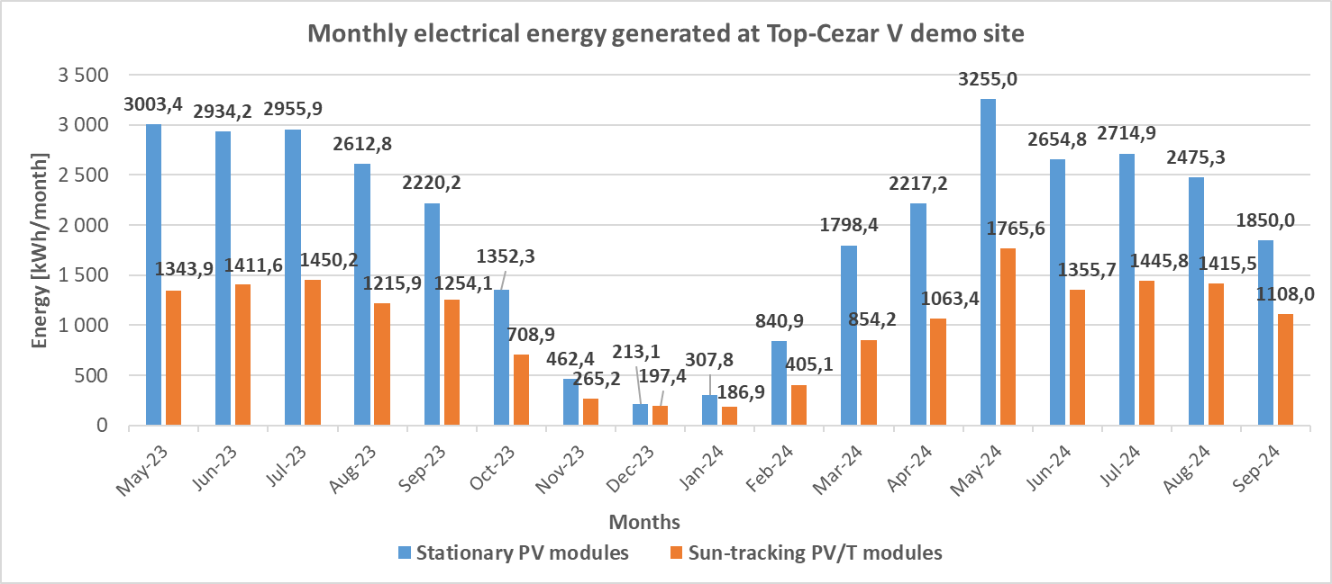
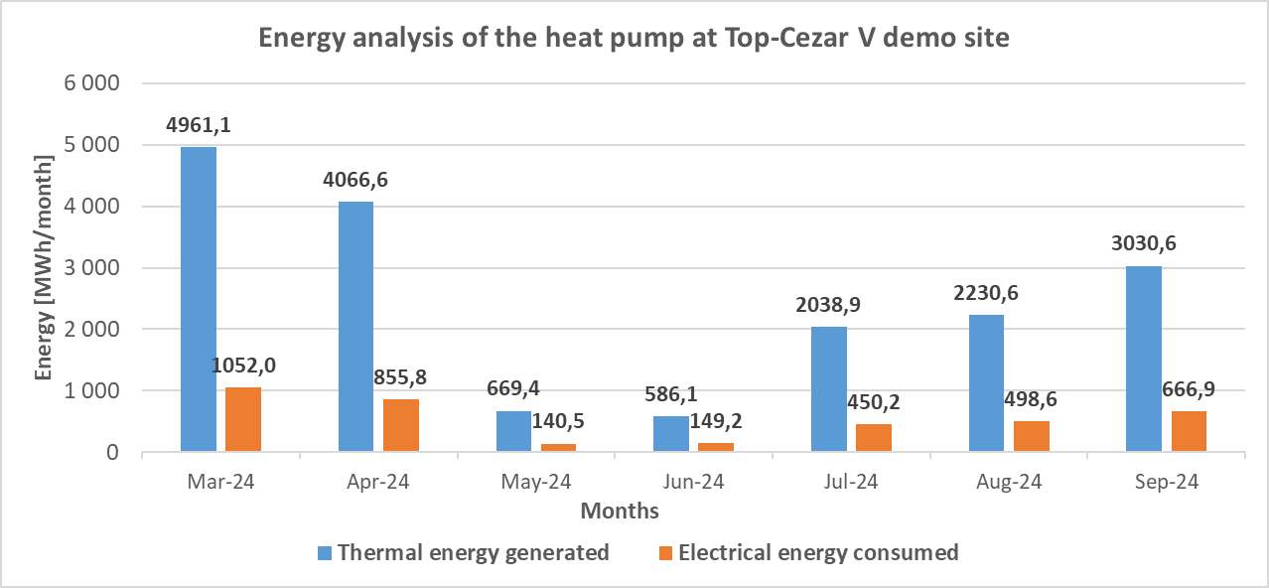
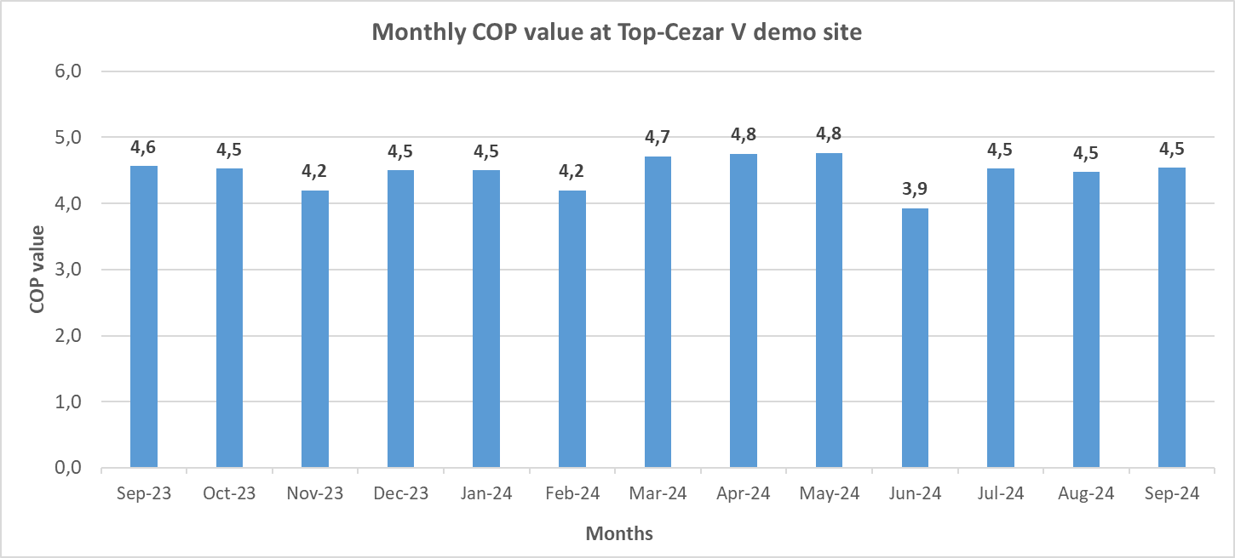
RESHeat - demo in Limanowa

Slide 12
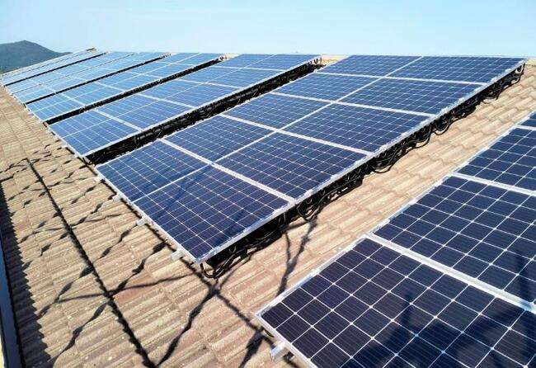
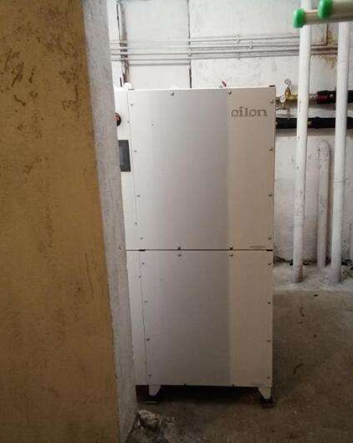
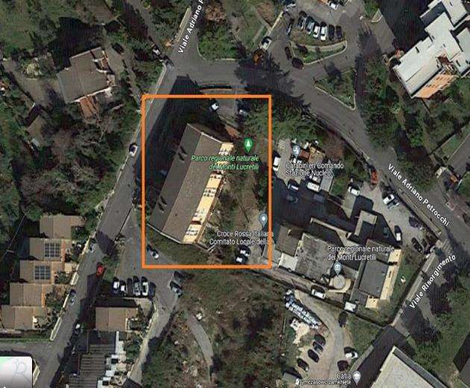
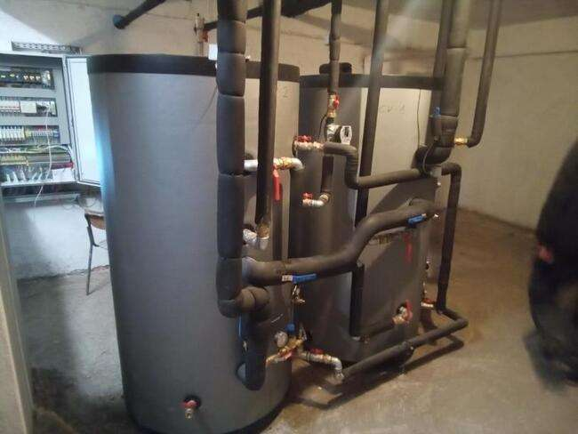
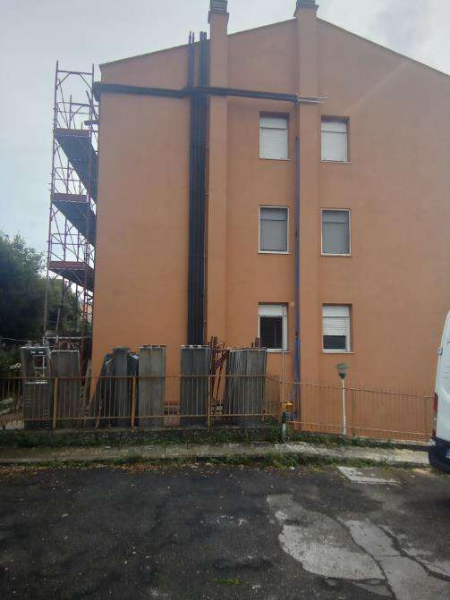
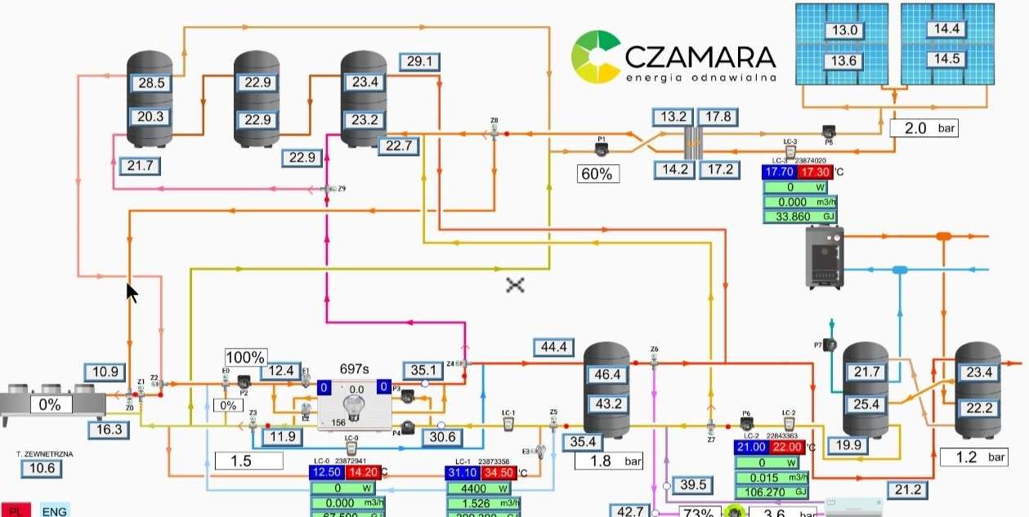
RESHeat - demo Palombara Sabina
Location: Palombara Sabina - Włochy
End-User: ATER Della Provincia di Roma
Year of construction: 1980 - 1985
Number of flats: 13
Heat source: natural gas
Installation power:
PVT modules : 22.5 kWe, 30 kWt
Heat pump: 75 kW with Drycooler
Thermal Energy storage: 3 m³

Slide 13
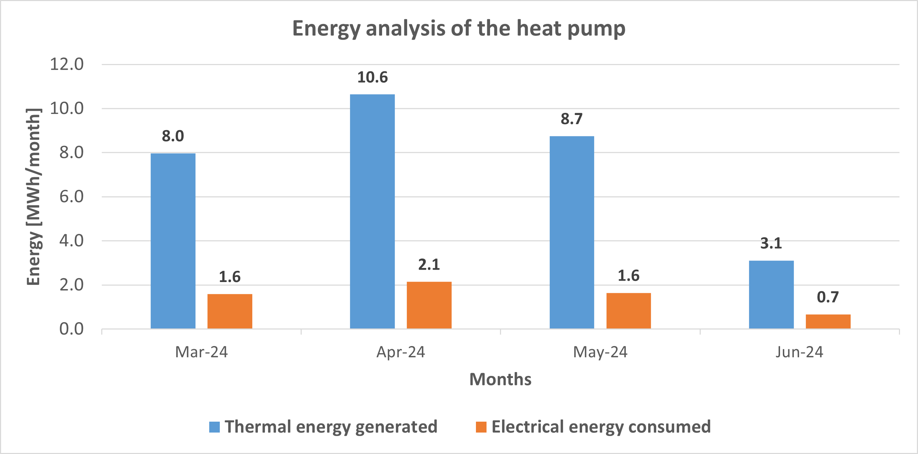
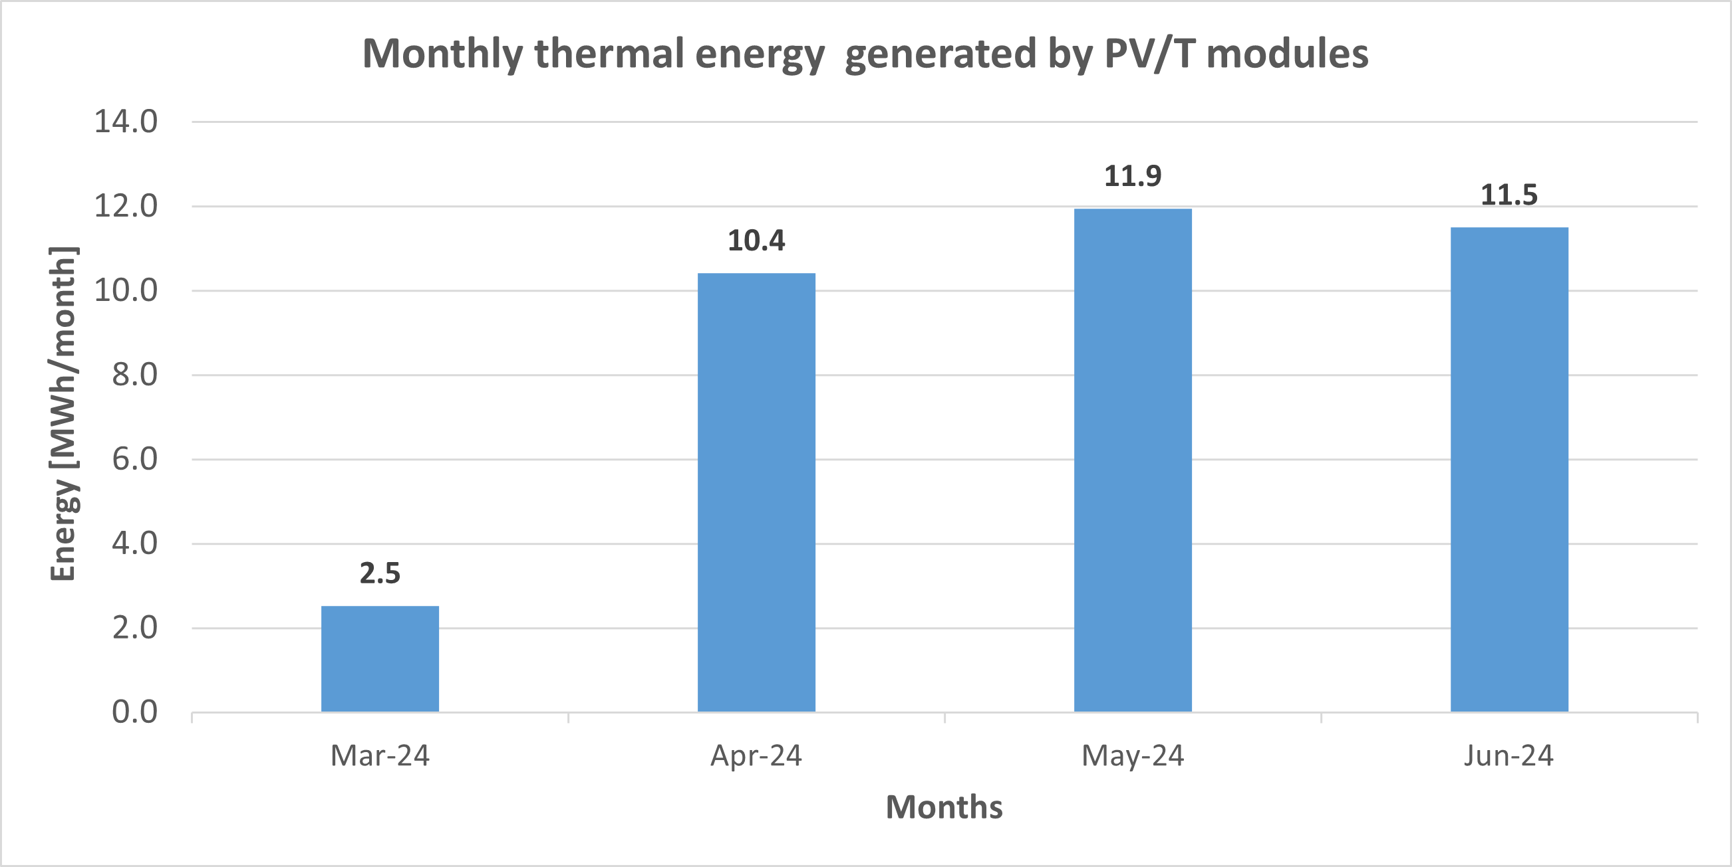
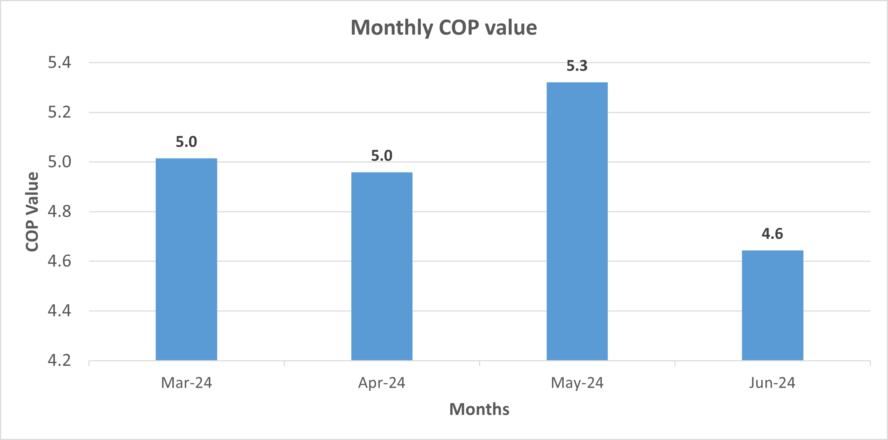
RESHeat - demo Palombara Sabina

Slide 14
Stakeholders
1. Multi-Apartment Building Owners & Housing Cooperatives
Especially existing buildings undergoing modernization and new developments aiming for sustainability.
Seeking low operating costs, energy independence, and compliance with EU regulations.
2. Residents & End-Users
Individuals and families living in buildings equipped with RESHeat. Benefit from:
Lower energy bills
Improved comfort (heating, cooling, hot water)
Stable prices not linked to fossil fuel markets
3. Local Governments & Municipalities
Especially those managing social housing or public housing programs. Interested in:
Reducing greenhouse gas emissions
Promoting energy self-sufficiency
Reaching local and national climate targets
4. ESCOs (Energy Service Companies)
Can offer RESHeat as part of performance-based contracts to clients.
The high COP values (up to 4.5) make it financially attractive for ESCO-led retrofits.
5. Investors & Green Finance Providers
Institutions funding sustainable infrastructure, green bonds, or climate investment portfolios. RESHeat offers:
a) Scalability
b) Proven TRL9 and Commercial readiness
c) Measured performance

Slide 15
Expected competition
The RESHeat system competes with several existing technologies for building energy supply:
District Heating (fossil-based): Still common but carbon-intensive and centralized. RESHeat offers a fully renewable, decentralized alternative.
Air Source Heat Pumps: Widely used, but less efficient in cold climates and lack seasonal storage. RESHeat integrates underground thermal storage for stable year-round performance.
Geothermal Heat Pumps: Efficient but costly and space-demanding. RESHeat provides similar benefits with easier implementation in urban areas.
PV + Electric Heating: Simple but struggles in winter. RESHeat’s hybrid PVT system and storage ensure better seasonal balance.
Solar Thermal + Biomass: Renewable but complex and polluting. RESHeat is cleaner and easier to operate.
Commercial Hybrid Systems: Effective but often lack deep integration or seasonal storage. RESHeat is fully integrated and field-tested.

Slide 16
RESHeat replication is an opportunity for ...
Implementing a system for the production of electricity, and heat for heating and domestic hot water to cover up to 70% of a building's total annual energy needs from RES.
ensuring the scalability of the system for different types and sizes of residential, public and commercial buildings.
providing an alternative to conventional heating systems for buildings using fossil fuels - where gas piping or district heating networks are not possible/viable
support for industry and SME companies facing the energy transition.

Slide 17


Thank you for your attention
https://ke.pk.edu.pl/
https://resheat.eu/

